Slide 1
A* Search Algorithm
CSE318 July ’21 Semester

Slide 2

A* Search
Graph traversal algorithm
BFS
DFS
Bellman-Ford
Floyd- Warshall
Dijkstra
Finds the optimal path between two nodes of a graph
Best-First Search Algorithm
Greedy approach
Evaluation function $f\left(n\right)$ → Estimate of the total cost
Expands the node n with the smallest $f\left(n\right)$

Slide 3
Dijkstra Algorithm
Greedy technique like A*
Visits the nearest node
Visits too many nodes

Slide 4
Dijkstra
Oradea
71
Neamt
Zerind
87
75
151
Arad
Iasi
140
92
Sibiu
Faragas
118
99
Vaslui
80
Rimnicu Vilcea
Timisoara
211
142
111
Lugoj
97
Pitesi
70
98
Hirsova
Mehadia
146
101
85
Urziceni
75
138
86
Bucharest
Dobreta
120
90
Craiova
Eforie
Giurhiu

Slide 5
Dijkstra
Oradea
Node Expanded by Dijkstra
Arad
Start
Node
71
Neamt
Zerind
87
75
151
Arad
Iasi
140
92
Sibiu
Faragas
118
99
Vaslui
80
Rimnicu Vilcea
Timisoara
211
End
Node
142
111
Lugoj
97
Pitesi
70
98
Hirsova
Mehadia
146
101
85
Urziceni
75
138
86
Bucharest
Dobreta
120
90
Craiova
Eforie
Giurhiu

Slide 6
Dijkstra
Oradea
Node Expanded by Dijkstra
Arad
Sibiu
Timisoara
Zerind
Start
Node
71
Neamt
Zerind
87
75
151
Arad
Iasi
140
92
Sibiu
Faragas
118
99
Vaslui
80
Rimnicu Vilcea
Timisoara
211
End
Node
142
111
Lugoj
97
Pitesi
70
98
Hirsova
Mehadia
146
101
85
Urziceni
75
138
86
Bucharest
Dobreta
120
90
Craiova
Eforie
Giurhiu

Slide 7
Dijkstra
Oradea
Node Expanded by Dijkstra
Arad
Sibiu
Timisoara
Zerind
Start
Node
71
Neamt
Zerind
87
75
151
Arad
Iasi
140
92
Sibiu
Faragas
118
99
Vaslui
80
Rimnicu Vilcea
Timisoara
211
End
Node
142
111
Lugoj
97
Pitesi
70
98
Hirsova
Mehadia
146
101
85
Urziceni
75
138
86
Bucharest
Dobreta
120
90
Craiova
Eforie
Giurhiu

Slide 8
Dijkstra
Oradea
Node Expanded by Dijkstra
Arad
Zerind 75
Sibiu
Timisoara
Oradea
Start
Node
71
Neamt
Zerind
87
75
151
Arad
Iasi
140
92
Sibiu
Faragas
118
99
Vaslui
80
Rimnicu Vilcea
Timisoara
211
End
Node
142
111
Lugoj
97
Pitesi
70
98
Hirsova
Mehadia
146
101
85
Urziceni
75
138
86
Bucharest
Dobreta
120
90
Craiova
Eforie
Giurhiu

Slide 9
Dijkstra
Oradea
Node Expanded by Dijkstra
Arad
Zerind 75
Timisoara 118
Sibiu
Oradea
Lugoj
Start
Node
71
Neamt
Zerind
87
75
151
Arad
Iasi
140
92
Sibiu
Faragas
118
99
Vaslui
80
Rimnicu Vilcea
Timisoara
211
End
Node
142
111
Lugoj
97
Pitesi
70
98
Hirsova
Mehadia
146
101
85
Urziceni
75
138
86
Bucharest
Dobreta
120
90
Craiova
Eforie
Giurhiu

Slide 10
Dijkstra
Oradea
Node Expanded by Dijkstra
Arad
Zerind 75
Timisoara 118
Sibiu 140
Oradea
Lugoj
Faragas
Rimnicu Vilcea
Start
Node
71
Neamt
Zerind
87
75
151
Arad
Iasi
140
92
Sibiu
Faragas
118
99
Vaslui
80
Rimnicu Vilcea
Timisoara
211
End
Node
142
111
Lugoj
97
Pitesi
70
98
Hirsova
Mehadia
146
101
85
Urziceni
75
138
86
Bucharest
Dobreta
120
90
Craiova
Eforie
Giurhiu

Slide 11
Dijkstra
Oradea
Node Expanded by Dijkstra
Arad
Zerind 75
Timisoara 118
Sibiu 140
Oradea 146 (75 + 71)
Lugoj
Faragas
Rimnicu Vilcea
Start
Node
71
Neamt
Zerind
87
75
151
Arad
Iasi
140
92
Sibiu
Faragas
118
99
Vaslui
80
Rimnicu Vilcea
Timisoara
211
End
Node
142
111
Lugoj
97
Pitesi
70
98
Hirsova
Mehadia
146
101
85
Urziceni
75
138
86
Bucharest
Dobreta
120
90
Craiova
Eforie
Giurhiu

Slide 12
Dijkstra
Oradea
Node Expanded by Dijkstra
Arad
Zerind 75
Timisoara 118
Sibiu 140
Oradea 146 (75 + 71)
Rimnicu Vilcea 220 (140+80)
Lugoj
Faragas
Pitesi
Craiova
Start
Node
71
Neamt
Zerind
87
75
151
Arad
Iasi
140
92
Sibiu
Faragas
118
99
Vaslui
80
Timisoara
Rimnicu Vilcea
211
End
Node
142
111
Lugoj
97
Pitesi
70
98
Hirsova
Mehadia
146
101
85
Urziceni
75
138
86
Bucharest
Dobreta
120
90
Craiova
Eforie
Giurhiu

Slide 13
Dijkstra
Oradea
Node Expanded by Dijkstra
Arad
Zerind 75
Timisoara 118
Sibiu 140
Oradea 146 (75 + 71)
Rimnicu Vilcea 220 (140+80)
Lugoj 229 (118+111)
Faragas
Pitesi
Craiova
Mehadia
Start
Node
71
Neamt
Zerind
87
75
151
Arad
Iasi
140
92
Sibiu
Faragas
118
99
Vaslui
80
Timisoara
Rimnicu Vilcea
211
End
Node
142
111
Lugoj
97
Pitesi
70
98
Hirsova
Mehadia
146
101
85
Urziceni
75
138
86
Bucharest
Dobreta
120
90
Craiova
Eforie
Giurhiu

Slide 14
Dijkstra
Oradea
Node Expanded by Dijkstra
Arad
Zerind 75
Timisoara 118
Sibiu 140
Oradea 146 (75 + 71)
Rimnicu Vilcea 220 (140+80)
Lugoj 229 (118+111)
Faragas 239 (140+99)
Pitesi
Craiova
Mehadia
Bucharest
Start
Node
71
Neamt
Zerind
87
75
151
Arad
Iasi
140
92
Sibiu
Faragas
118
99
Vaslui
80
Timisoara
Rimnicu Vilcea
211
End
Node
142
111
Lugoj
97
Pitesi
70
98
Hirsova
Mehadia
146
101
85
Urziceni
75
138
86
Bucharest
Dobreta
120
90
Craiova
Eforie
Giurhiu

Slide 15
Dijkstra
Oradea
Node Expanded by Dijkstra
Arad
Zerind 75
Timisoara 118
Sibiu 140
Oradea 146 (75 + 71)
Rimnicu Vilcea 220 (140+80)
Lugoj 229 (118+111)
Faragas 239 (140+99)
Mehadia 299 (118+111+70)
Pitesi
Craiova
Bucharest
Dobreta
Start
Node
71
Neamt
Zerind
87
75
151
Arad
Iasi
140
92
Sibiu
Faragas
118
99
Vaslui
80
Timisoara
Rimnicu Vilcea
211
End
Node
142
111
Lugoj
97
Pitesi
70
98
Hirsova
Mehadia
146
101
85
Urziceni
75
138
86
Bucharest
Dobreta
120
90
Craiova
Eforie
Giurhiu

Slide 16
Dijkstra
Oradea
Node Expanded by Dijkstra
Arad
Zerind 75
Timisoara 118
Sibiu 140
Oradea 146 (75 + 71)
Rimnicu Vilcea 220 (140+80)
Lugoj 229 (118+111)
Faragas 239 (140+99)
Mehadia 299 (118+111+70)
Pitesi 317 (140+80+97)
Craiova
Bucharest
Dobreta
Start
Node
71
Neamt
Zerind
87
75
151
Arad
Iasi
140
92
Sibiu
Faragas
118
99
Vaslui
80
Timisoara
Rimnicu Vilcea
211
End
Node
142
111
Lugoj
97
Pitesi
70
98
Hirsova
Mehadia
146
101
85
Urziceni
75
138
86
Bucharest
Dobreta
120
90
Craiova
Eforie
Giurhiu

Slide 17
Dijkstra
Oradea
Node Expanded by Dijkstra
Arad
Zerind 75
Timisoara 118
Sibiu 140
Oradea 146 (75 + 71)
Rimnicu Vilcea 220 (140+80)
Lugoj 229 (118+111)
Faragas 239 (140+99)
Mehadia 299 (118+111+70)
Pitesi 317 (140+80+97)
Craiova 366 (140+80+146)
Bucharest
Dobreta
Start
Node
71
Neamt
Zerind
87
75
151
Arad
Iasi
140
92
Sibiu
Faragas
118
99
Vaslui
80
Timisoara
Rimnicu Vilcea
211
End
Node
142
111
Lugoj
97
Pitesi
70
98
Hirsova
Mehadia
146
101
85
Urziceni
75
138
86
Bucharest
Dobreta
120
90
Craiova
Eforie
Giurhiu

Slide 18
Dijkstra
Oradea
Node Expanded by Dijkstra
Arad
Zerind 75
Timisoara 118
Sibiu 140
Oradea 146 (75 + 71)
Rimnicu Vilcea 220 (140+80)
Lugoj 229 (118+111)
Faragas 239 (140+99)
Mehadia 299 (118+111+70)
Pitesi 317 (140+80+97)
Craiova 366 (140+80+146)
Dobreta 374 (118+111+70+75)
Bucharest
Start
Node
71
Neamt
Zerind
87
75
151
Arad
Iasi
140
92
Sibiu
Faragas
118
99
Vaslui
80
Timisoara
Rimnicu Vilcea
211
End
Node
142
111
Lugoj
97
Pitesi
70
98
Hirsova
Mehadia
146
101
85
Urziceni
75
138
86
Bucharest
Dobreta
120
90
Craiova
Eforie
Giurhiu

Slide 19
Dijkstra
Oradea
Node Expanded by Dijkstra
Arad
Zerind 75
Timisoara 118
Sibiu 140
Oradea 146 (75 + 71)
Rimnicu Vilcea 220 (140+80)
Lugoj 229 (118+111)
Faragas 239 (140+99)
Mehadia 299 (118+111+70)
Pitesi 317 (140+80+97)
Craiova 366 (140+80+146)
Dobreta 374 (118+111+70+75)
Bucharest 418 (140+80+97+101)
Start
Node
71
Neamt
Zerind
87
75
151
Arad
Iasi
140
92
Sibiu
Faragas
118
99
Vaslui
80
Timisoara
Rimnicu Vilcea
211
End
Node
142
111
Lugoj
97
Pitesi
70
98
Hirsova
Mehadia
146
101
85
Urziceni
75
138
86
Bucharest
Dobreta
120
90
Craiova
Eforie
Giurhiu

Slide 20
Dijkstra
11 intermediate nodes expanded !! 😔
Oradea
Node Expanded by Dijkstra
Arad
Zerind 75
Timisoara 118
Sibiu 140
Oradea 146 (75 + 71)
Rimnicu Vilcea 220 (140+80)
Lugoj 229 (118+111)
Faragas 239 (140+99)
Mehadia 299 (118+111+70)
Pitesi 317 (140+80+97)
Craiova 366 (140+80+146)
Dobreta 374 (118+111+70+75)
Bucharest 418 (140+80+97+101)
Start
Node
71
Neamt
Zerind
87
75
151
Arad
Iasi
140
92
Sibiu
Faragas
118
99
Vaslui
80
Timisoara
Rimnicu Vilcea
211
End
Node
142
111
Lugoj
97
Pitesi
70
98
Hirsova
Mehadia
146
101
85
Urziceni
75
138
86
Bucharest
Dobreta
120
90
Craiova
Eforie
Giurhiu

Slide 21
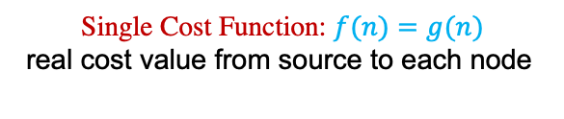
Dijkstra
Single Cost Function: $f(n)=g(n)$
real cost value from source to each node
Oradea
Node Expanded by Dijkstra
Arad
Zerind 75
Timisoara 118
Sibiu 140
Oradea 146 (75 + 71)
Rimnicu Vilcea 220 (140+80)
Lugoj 229 (118+111)
Faragas 239 (140+99)
Mehadia 299 (118+111+70)
Pitesi 317 (140+80+97)
Craiova 366 (140+80+146)
Dobreta 374 (118+111+70+75)
Bucharest 418 (140+80+97+101)
Start
Node
71
Neamt
Zerind
87
75
151
Arad
Iasi
140
92
Sibiu
Faragas
118
99
Vaslui
80
Timisoara
Rimnicu Vilcea
211
End
Node
142
111
Lugoj
97
Pitesi
70
98
Hirsova
Mehadia
146
101
85
Urziceni
75
138
86
Bucharest
Dobreta
120
90
Craiova
Eforie
Giurhiu

Slide 22
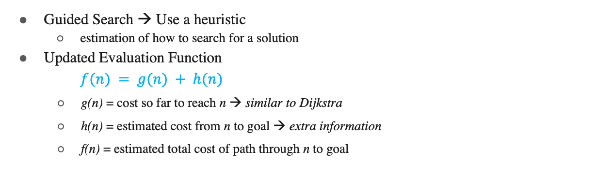
Heuristic
Guided Search → Use a heuristic
estimation of how to search for a solution
Updated Evaluation Function
$f(n) = g(n) + h(n)$
g(n) = cost so far to reach n → similar to Dijkstra
h(n) = estimated cost from n to goal → extra information
f(n) = estimated total cost of path through n to goal

Slide 23
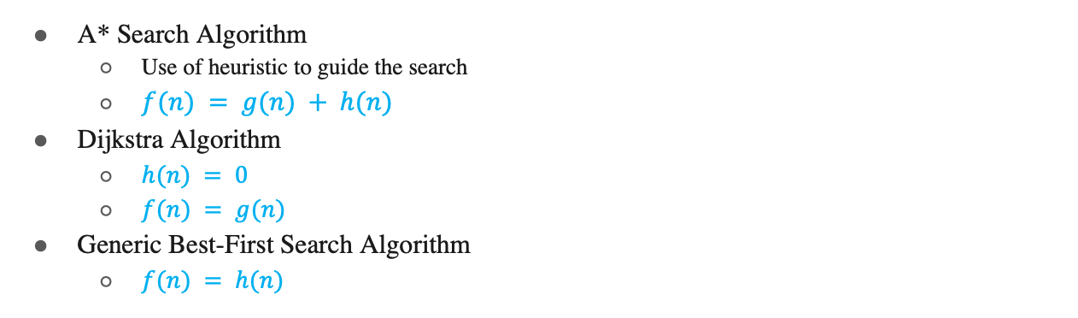
Summary
A* Search Algorithm
Use of heuristic to guide the search
$f(n) = g(n) + h(n)$
Dijkstra Algorithm
$h(n) = 0$
$f(n) = g(n)$
Generic Best-First Search Algorithm
$f(n) = h(n)$

Slide 24
A* Search
Oradea
Straight Line distance to Bucharest
Arad 366
Bucharest 0
Craiova 160
Dobreta 242
Eforie 161
Faragas 176
Giurhiu 77
Hirsova 151
Iasi 226
Lugoj 244
Mehadia 241
Neamt 234
Oradea 380
Pitesi 100
Rimnicu Vilcea 193
Sibiu 253
Timisoara 329
Urziceni 80
Vaslui 199
Zerind 374
Start
Node
71
Neamt
Zerind
87
75
151
Arad
Iasi
140
92
Sibiu
Faragas
118
99
Vaslui
80
Rimnicu Vilcea
Timisoara
211
End
Node
142
111
Lugoj
97
Pitesi
70
98
Hirsova
Mehadia
146
101
85
Urziceni
75
138
86
Bucharest
Dobreta
120
90
Craiova
Eforie
Giurhiu

Slide 25
A* Search
Arad
Sibiu
Timisoara
Zerind

Slide 26
A* Search
Zerind: f(n) = g(n) + h(n) = 75 + 374 = 449
Timisoara: f(n) = g(n) + h(n) = 118 + 329 = 447
Sibiu: f(n) = g(n) + h(n) = 140 + 253 = 393
Oradea
Straight Line distance to Bucharest
Arad 366
Bucharest 0
Craiova 160
Dobreta 242
Eforie 161
Faragas 176
Giurhiu 77
Hirsova 151
Iasi 226
Lugoj 244
Mehadia 241
Neamt 234
Oradea 380
Pitesi 100
Rimnicu Vilcea 193
Sibiu 253
Timisoara 329
Urziceni 80
Vaslui 199
Zerind 374
Start
Node
71
Neamt
Zerind
87
75
151
Arad
Iasi
140
92
Sibiu
Faragas
118
99
Vaslui
80
Rimnicu Vilcea
Timisoara
211
End
Node
142
111
Lugoj
97
Pitesi
70
98
Hirsova
Mehadia
146
101
85
Urziceni
75
138
86
Bucharest
Dobreta
120
90
Craiova
Eforie
Giurhiu

Slide 27
A* Search
Zerind: f(n) = g(n) + h(n) = 75 + 374 = 449
Timisoara: f(n) = g(n) + h(n) = 118 + 329 = 447
Sibiu: f(n) = g(n) + h(n) = 140 + 253 = 393
Oradea
Straight Line distance to Bucharest
Arad 366
Bucharest 0
Craiova 160
Dobreta 242
Eforie 161
Faragas 176
Giurhiu 77
Hirsova 151
Iasi 226
Lugoj 244
Mehadia 241
Neamt 234
Oradea 380
Pitesi 100
Rimnicu Vilcea 193
Sibiu 253
Timisoara 329
Urziceni 80
Vaslui 199
Zerind 374
Start
Node
71
Neamt
Zerind
87
75
151
Arad
Iasi
140
92
Sibiu
Faragas
118
99
Vaslui
80
Rimnicu Vilcea
Timisoara
211
End
Node
142
111
Lugoj
97
Pitesi
70
98
Hirsova
Mehadia
146
101
85
Urziceni
75
138
86
Bucharest
Dobreta
120
90
Craiova
Eforie
Giurhiu

Slide 28
A* Search
Zerind: f(n) = g(n) + h(n) = 75 + 374 = 449
Timisoara: f(n) = g(n) + h(n) = 118 + 329 = 447
Sibiu: f(n) = g(n) + h(n) = 140 + 253 = 393
Oradea
Straight Line distance to Bucharest
Arad 366
Bucharest 0
Craiova 160
Dobreta 242
Eforie 161
Faragas 176
Giurhiu 77
Hirsova 151
Iasi 226
Lugoj 244
Mehadia 241
Neamt 234
Oradea 380
Pitesi 100
Rimnicu Vilcea 193
Sibiu 253
Timisoara 329
Urziceni 80
Vaslui 199
Zerind 374
Start
Node
71
Neamt
Zerind
87
75
151
Arad
Iasi
140
92
Sibiu
Faragas
118
99
Vaslui
80
Rimnicu Vilcea
Timisoara
211
End
Node
142
111
Lugoj
97
Pitesi
70
98
Hirsova
Mehadia
146
101
85
Urziceni
75
138
86
Bucharest
Dobreta
120
90
Craiova
Eforie
Giurhiu

Slide 29
A* Search
Zerind: f(n) = g(n) + h(n) = 75 + 374 = 449
Timisoara: f(n) = g(n) + h(n) = 118 + 329 = 447
Sibiu: f(n) = g(n) + h(n) = 140 + 253 = 393
Oradea
Straight Line distance to Bucharest
Arad 366
Bucharest 0
Craiova 160
Dobreta 242
Eforie 161
Faragas 176
Giurhiu 77
Hirsova 151
Iasi 226
Lugoj 244
Mehadia 241
Neamt 234
Oradea 380
Pitesi 100
Rimnicu Vilcea 193
Sibiu 253
Timisoara 329
Urziceni 80
Vaslui 199
Zerind 374
Start
Node
71
Neamt
Zerind
87
75
151
Arad
Iasi
140
92
Sibiu
Faragas
118
99
Vaslui
80
Rimnicu Vilcea
Timisoara
211
End
Node
142
111
Lugoj
97
Pitesi
70
98
Hirsova
Mehadia
146
101
85
Urziceni
75
138
86
Bucharest
Dobreta
120
90
Craiova
Eforie
Giurhiu

Slide 30
A* Search
Zerind: f(n) = g(n) + h(n) = 75 + 374 = 449
Timisoara: f(n) = g(n) + h(n) = 118 + 329 = 447
Sibiu: f(n) = g(n) + h(n) = 140 + 253 = 393
Oradea
Straight Line distance to Bucharest
Arad 366
Bucharest 0
Craiova 160
Dobreta 242
Eforie 161
Faragas 176
Giurhiu 77
Hirsova 151
Iasi 226
Lugoj 244
Mehadia 241
Neamt 234
Oradea 380
Pitesi 100
Rimnicu Vilcea 193
Sibiu 253
Timisoara 329
Urziceni 80
Vaslui 199
Zerind 374
Start
Node
71
Neamt
Zerind
87
75
151
Arad
Iasi
140
92
Sibiu
Faragas
118
99
Vaslui
80
Rimnicu Vilcea
Timisoara
211
End
Node
142
111
Lugoj
97
Pitesi
70
98
Hirsova
Mehadia
146
101
85
Urziceni
75
138
86
Bucharest
Dobreta
120
90
Craiova
Eforie
Giurhiu

Slide 31
A* Search
Arad
Sibiu
Timisoara
Zerind
140 + 253 = 393
118 + 329 = 447
75 + 374 = 449

Slide 32
A* Search
Arad
Sibiu
Timisoara
Zerind
118 + 329 = 447
75 + 374 = 449
Arad
Faragas
Oradea
Rimnicu
Vilcia

Slide 33
A* Search
Zerind: f(n) = g(n) + h(n) = 75 + 374 = 449
Timisoara: f(n) = g(n) + h(n) = 118 + 329 = 447
Faragas: f(n) = g(n) + h(n) = (140 + 99) + 176 = 415
Rimnicu Vilcea: f(n) = g(n) + h(n) = (140 + 80) + 193 = 413
Oradea: f(n) = g(n) + h(n) = (140 + 151) + 380 = 671
Arad: f(n) = g(n) + h(n) = (140 + 140) + 366 = 646
Oradea
Straight Line distance to Bucharest
Arad 366
Bucharest 0
Craiova 160
Dobreta 242
Eforie 161
Faragas 176
Giurhiu 77
Hirsova 151
Iasi 226
Lugoj 244
Mehadia 241
Neamt 234
Oradea 380
Pitesi 100
Rimnicu Vilcea 193
Sibiu 253
Timisoara 329
Urziceni 80
Vaslui 199
Zerind 374
Start
Node
71
Neamt
Zerind
87
75
151
Arad
Iasi
140
92
Sibiu
Faragas
118
99
Vaslui
80
Rimnicu Vilcea
Timisoara
211
End
Node
142
111
Lugoj
97
Pitesi
70
98
Hirsova
Mehadia
146
101
85
Urziceni
75
138
86
Bucharest
Dobreta
120
90
Craiova
Eforie
Giurhiu

Slide 34
A* Search
Zerind: f(n) = g(n) + h(n) = 75 + 374 = 449
Timisoara: f(n) = g(n) + h(n) = 118 + 329 = 447
Faragas: f(n) = g(n) + h(n) = (140 + 99) + 176 = 415
Rimnicu Vilcea: f(n) = g(n) + h(n) = (140 + 80) + 193 = 413
Oradea: f(n) = g(n) + h(n) = (140 + 151) + 380 = 671
Arad: f(n) = g(n) + h(n) = (140 + 140) + 366 = 646
Oradea
Straight Line distance to Bucharest
Arad 366
Bucharest 0
Craiova 160
Dobreta 242
Eforie 161
Faragas 176
Giurhiu 77
Hirsova 151
Iasi 226
Lugoj 244
Mehadia 241
Neamt 234
Oradea 380
Pitesi 100
Rimnicu Vilcea 193
Sibiu 253
Timisoara 329
Urziceni 80
Vaslui 199
Zerind 374
Start
Node
71
Neamt
Zerind
87
75
151
Arad
Iasi
140
92
Sibiu
Faragas
118
99
Vaslui
80
Rimnicu Vilcea
Timisoara
211
End
Node
142
111
Lugoj
97
Pitesi
70
98
Hirsova
Mehadia
146
101
85
Urziceni
75
138
86
Bucharest
Dobreta
120
90
Craiova
Eforie
Giurhiu

Slide 35
A* Search
Arad
Sibiu
Timisoara
Zerind
118 + 329 = 447
75 + 374 = 449
Arad
Faragas
Oradea
Rimnicu
Vilcia
280 + 366 = 646
239 + 176 = 415
291 + 380 = 671
220 + 193 = 413

Slide 36
A* Search
Arad
Sibiu
Timisoara
Zerind
118 + 329 = 447
75 + 374 = 449
Arad
Faragas
Oradea
Rimnicu
Vilcia
280 + 366 = 646
239 + 176 = 415
291 + 380 = 671
Craiova
Pitesi
Sibiu

Slide 37
A* Search
Zerind: f(n) = g(n) + h(n) = 75 + 374 = 449
Timisoara: f(n) = g(n) + h(n) = 118 + 329 = 447
Faragas: f(n) = g(n) + h(n) = (140 + 99) + 176 = 415
Oradea: f(n) = g(n) + h(n) = (140 + 151) + 380 = 671
Arad: f(n) = g(n) + h(n) = (140 + 140) + 366 = 646
Pitesi: f(n) = g(n) + h(n) = (140 + 80 + 97) + 100 = 417
Craiova: f(n) = g(n) + h(n) = (140 + 80 + 146) + 160 = 526
Sibiu:
Oradea
Straight Line distance to Bucharest
Arad 366
Bucharest 0
Craiova 160
Dobreta 242
Eforie 161
Faragas 176
Giurhiu 77
Hirsova 151
Iasi 226
Lugoj 244
Mehadia 241
Neamt 234
Oradea 380
Pitesi 100
Rimnicu Vilcea 193
Sibiu 253
Timisoara 329
Urziceni 80
Vaslui 199
Zerind 374
Start
Node
71
Neamt
Zerind
87
75
151
Arad
Iasi
140
92
Sibiu
Faragas
118
99
Vaslui
80
Rimnicu Vilcea
Timisoara
211
End
Node
142
111
Lugoj
97
Pitesi
70
98
Hirsova
Mehadia
146
101
85
Urziceni
75
138
86
Bucharest
Dobreta
120
90
Craiova
Eforie
Giurhiu

Slide 38
A* Search
Zerind: f(n) = g(n) + h(n) = 75 + 374 = 449
Timisoara: f(n) = g(n) + h(n) = 118 + 329 = 447
Faragas: f(n) = g(n) + h(n) = (140 + 99) + 176 = 415
Oradea: f(n) = g(n) + h(n) = (140 + 151) + 380 = 671
Arad: f(n) = g(n) + h(n) = (140 + 140) + 366 = 646
Pitesi: f(n) = g(n) + h(n) = (140 + 80 + 97) + 100 = 417
Craiova: f(n) = g(n) + h(n) = (140 + 80 + 146) + 160 = 526
Sibiu:
Oradea
Straight Line distance to Bucharest
Arad 366
Bucharest 0
Craiova 160
Dobreta 242
Eforie 161
Faragas 176
Giurhiu 77
Hirsova 151
Iasi 226
Lugoj 244
Mehadia 241
Neamt 234
Oradea 380
Pitesi 100
Rimnicu Vilcea 193
Sibiu 253
Timisoara 329
Urziceni 80
Vaslui 199
Zerind 374
Start
Node
71
Neamt
Zerind
87
75
151
Arad
Iasi
140
92
Sibiu
Faragas
118
99
Vaslui
80
Rimnicu Vilcea
Timisoara
211
End
Node
142
111
Lugoj
97
Pitesi
70
98
Hirsova
Mehadia
146
101
85
Urziceni
75
138
86
Bucharest
Dobreta
120
90
Craiova
Eforie
Giurhiu

Slide 39
A* Search
Arad
Sibiu
Timisoara
Zerind
118 + 329 = 447
75 + 374 = 449
Arad
Faragas
Oradea
Rimnicu
Vilcia
280 + 366 = 646
239 + 176 = 415
291 + 380 = 671
Craiova
Pitesi
Sibiu
366 + 160 = 526
317 + 100 = 417
300 + 253 = 553

Slide 40
A* Search
Arad
Sibiu
Timisoara
Zerind
118 + 329 = 447
75 + 374 = 449
Arad
Faragas
Oradea
Rimnicu
Vilcia
280 + 366 = 646
291 + 380 = 671
Sibiu
Bucharest
Craiova
Pitesi
Sibiu
366 + 160 = 526
317 + 100 = 417
300 + 253 = 553

Slide 41
A* Search
Zerind: f(n) = g(n) + h(n) = 75 + 374 = 449
Timisoara: f(n) = g(n) + h(n) = 118 + 329 = 447
Oradea: f(n) = g(n) + h(n) = (140 + 151) + 380 = 671
Arad: f(n) = g(n) + h(n) = (140 + 140) + 366 = 646
Pitesi: f(n) = g(n) + h(n) = (140 + 80 + 97) + 100 = 417
Craiova: f(n) = g(n) + h(n) = (140 + 80 + 146) + 160 = 526
Bucharest: f(n) = g(n) + h(n) = (140 + 99 + 211) + 0 = 450
Sibiu:
Through Faragas
Oradea
Straight Line distance to Bucharest
Arad 366
Bucharest 0
Craiova 160
Dobreta 242
Eforie 161
Faragas 176
Giurhiu 77
Hirsova 151
Iasi 226
Lugoj 244
Mehadia 241
Neamt 234
Oradea 380
Pitesi 100
Rimnicu Vilcea 193
Sibiu 253
Timisoara 329
Urziceni 80
Vaslui 199
Zerind 374
Start
Node
71
Neamt
Zerind
87
75
151
Arad
Iasi
140
92
Sibiu
Faragas
118
99
Vaslui
80
Rimnicu Vilcea
Timisoara
211
End
Node
142
111
Lugoj
97
Pitesi
70
98
Hirsova
Mehadia
146
101
85
Urziceni
75
138
86
Bucharest
Dobreta
120
90
Craiova
Eforie
Giurhiu

Slide 42
A* Search
Zerind: f(n) = g(n) + h(n) = 75 + 374 = 449
Timisoara: f(n) = g(n) + h(n) = 118 + 329 = 447
Oradea: f(n) = g(n) + h(n) = (140 + 151) + 380 = 671
Arad: f(n) = g(n) + h(n) = (140 + 140) + 366 = 646
Pitesi: f(n) = g(n) + h(n) = (140 + 80 + 97) + 100 = 417
Craiova: f(n) = g(n) + h(n) = (140 + 80 + 146) + 160 = 526
Bucharest: f(n) = g(n) + h(n) = (140 + 99 + 211) + 0 = 450
Sibiu:
Through Faragas
Oradea
Straight Line distance to Bucharest
Arad 366
Bucharest 0
Craiova 160
Dobreta 242
Eforie 161
Faragas 176
Giurhiu 77
Hirsova 151
Iasi 226
Lugoj 244
Mehadia 241
Neamt 234
Oradea 380
Pitesi 100
Rimnicu Vilcea 193
Sibiu 253
Timisoara 329
Urziceni 80
Vaslui 199
Zerind 374
Start
Node
71
Neamt
Zerind
87
75
151
Arad
Iasi
140
92
Sibiu
Faragas
118
99
Vaslui
80
Rimnicu Vilcea
Timisoara
211
End
Node
142
111
Lugoj
97
Pitesi
70
98
Hirsova
Mehadia
146
101
85
Urziceni
75
138
86
Bucharest
Dobreta
120
90
Craiova
Eforie
Giurhiu

Slide 43
A* Search
Zerind: f(n) = g(n) + h(n) = 75 + 374 = 449
Timisoara: f(n) = g(n) + h(n) = 118 + 329 = 447
Oradea: f(n) = g(n) + h(n) = (140 + 151) + 380 = 671
Arad: f(n) = g(n) + h(n) = (140 + 140) + 366 = 646
Pitesi: f(n) = g(n) + h(n) = (140 + 80 + 97) + 100 = 417
Craiova: f(n) = g(n) + h(n) = (140 + 80 + 146) + 160 = 526
Bucharest: f(n) = g(n) + h(n) = (140 + 99 + 211) + 0 = 450
Sibiu:
Through Faragas
Oradea
Straight Line distance to Bucharest
Arad 366
Bucharest 0
Craiova 160
Dobreta 242
Eforie 161
Faragas 176
Giurhiu 77
Hirsova 151
Iasi 226
Lugoj 244
Mehadia 241
Neamt 234
Oradea 380
Pitesi 100
Rimnicu Vilcea 193
Sibiu 253
Timisoara 329
Urziceni 80
Vaslui 199
Zerind 374
Start
Node
71
Neamt
Zerind
87
75
151
Arad
Iasi
140
92
Sibiu
Faragas
118
99
Vaslui
80
Rimnicu Vilcea
Timisoara
211
End
Node
142
111
Lugoj
97
Pitesi
70
98
Hirsova
Mehadia
146
101
85
Urziceni
75
138
86
Bucharest
Dobreta
120
90
Craiova
Eforie
Giurhiu

Slide 44
A* Search
Zerind: f(n) = g(n) + h(n) = 75 + 374 = 449
Timisoara: f(n) = g(n) + h(n) = 118 + 329 = 447
Oradea: f(n) = g(n) + h(n) = (140 + 151) + 380 = 671
Arad: f(n) = g(n) + h(n) = (140 + 140) + 366 = 646
Pitesi: f(n) = g(n) + h(n) = (140 + 80 + 97) + 100 = 417
Craiova: f(n) = g(n) + h(n) = (140 + 80 + 146) + 160 = 526
Bucharest: f(n) = g(n) + h(n) = (140 + 99 + 211) + 0 = 450
Sibiu:
Through Faragas
Oradea
Straight Line distance to Bucharest
Arad 366
Bucharest 0
Craiova 160
Dobreta 242
Eforie 161
Faragas 176
Giurhiu 77
Hirsova 151
Iasi 226
Lugoj 244
Mehadia 241
Neamt 234
Oradea 380
Pitesi 100
Rimnicu Vilcea 193
Sibiu 253
Timisoara 329
Urziceni 80
Vaslui 199
Zerind 374
Start
Node
71
Neamt
Zerind
87
75
151
Arad
Iasi
140
92
Sibiu
Faragas
118
99
Vaslui
80
Rimnicu Vilcea
Timisoara
211
End
Node
142
111
Lugoj
97
Pitesi
70
98
Hirsova
Mehadia
146
101
85
Urziceni
75
138
86
Bucharest
Dobreta
120
90
Craiova
Eforie
Giurhiu

Slide 45
A* Search
Arad
Sibiu
Timisoara
Zerind
118 + 329 = 447
75 + 374 = 449
Arad
Faragas
Oradea
Rimnicu
Vilcia
280 + 366 = 646
291 + 380 = 671
Sibiu
Bucharest
Craiova
Pitesi
Sibiu
338 + 253 = 591
450 + 0 = 450
366 + 160 = 526
317 + 100 = 417
300 + 253 = 553

Slide 46
A* Search
Arad
Sibiu
Timisoara
Zerind
118 + 329 = 447
75 + 374 = 449
Arad
Faragas
Oradea
Rimnicu
Vilcia
280 + 366 = 646
291 + 380 = 671
Sibiu
Bucharest
Craiova
Pitesi
Sibiu
338 + 253 = 591
450 + 0 = 450
366 + 160 = 526
300 + 253 = 553
Bucharest
Craiova
Rimnicu
Vilcia

Slide 47
A* Search
Zerind: f(n) = g(n) + h(n) = 75 + 374 = 449
Timisoara: f(n) = g(n) + h(n) = 118 + 329 = 447
Oradea: f(n) = g(n) + h(n) = (140 + 151) + 380 = 671
Arad: f(n) = g(n) + h(n) = (140 + 140) + 366 = 646
Craiova: f(n) = g(n) + h(n) = (140 + 80 + 146) + 160 = 526
Bucharest: f(n) = g(n) + h(n) = (140 + 99 + 211) + 0 = 450
Bucharest: f(n) = g(n) + h(n) = (140 + 80 + 97+101) + 0 = 418
Craiova:
Rimnicu Vilcea:
Through Faragas
Through Pitesi
Oradea
Straight Line distance to Bucharest
Arad 366
Bucharest 0
Craiova 160
Dobreta 242
Eforie 161
Faragas 176
Giurhiu 77
Hirsova 151
Iasi 226
Lugoj 244
Mehadia 241
Neamt 234
Oradea 380
Pitesi 100
Rimnicu Vilcea 193
Sibiu 253
Timisoara 329
Urziceni 80
Vaslui 199
Zerind 374
Start
Node
71
Neamt
Zerind
87
75
151
Arad
Iasi
140
92
Sibiu
Faragas
118
99
Vaslui
80
Rimnicu Vilcea
Timisoara
211
End
Node
142
111
Lugoj
97
Pitesi
70
98
Hirsova
Mehadia
146
101
85
Urziceni
75
138
86
Bucharest
Dobreta
120
90
Craiova
Eforie
Giurhiu

Slide 48
A* Search
Zerind: f(n) = g(n) + h(n) = 75 + 374 = 449
Timisoara: f(n) = g(n) + h(n) = 118 + 329 = 447
Oradea: f(n) = g(n) + h(n) = (140 + 151) + 380 = 671
Arad: f(n) = g(n) + h(n) = (140 + 140) + 366 = 646
Craiova: f(n) = g(n) + h(n) = (140 + 80 + 146) + 160 = 526
Bucharest: f(n) = g(n) + h(n) = (140 + 99 + 211) + 0 = 450
Bucharest: f(n) = g(n) + h(n) = (140 + 80 + 97+101) + 0 = 418
Craiova:
Rimnicu Vilcea:
Through Faragas
Through Pitesi
Oradea
Straight Line distance to Bucharest
Arad 366
Bucharest 0
Craiova 160
Dobreta 242
Eforie 161
Faragas 176
Giurhiu 77
Hirsova 151
Iasi 226
Lugoj 244
Mehadia 241
Neamt 234
Oradea 380
Pitesi 100
Rimnicu Vilcea 193
Sibiu 253
Timisoara 329
Urziceni 80
Vaslui 199
Zerind 374
Start
Node
71
Neamt
Zerind
87
75
151
Arad
Iasi
140
92
Sibiu
Faragas
118
99
Vaslui
80
Rimnicu Vilcea
Timisoara
211
End
Node
142
111
Lugoj
97
Pitesi
70
98
Hirsova
Mehadia
146
101
85
Urziceni
75
138
86
Bucharest
Dobreta
120
90
Craiova
Eforie
Giurhiu

Slide 49
A* Search
Arad
Sibiu
Timisoara
Zerind
118 + 329 = 447
75 + 374 = 449
Arad
Faragas
Oradea
Rimnicu
Vilcia
280 + 366 = 646
291 + 380 = 671
Sibiu
Bucharest
Craiova
Pitesi
Sibiu
338 + 253 = 591
450 + 0 = 450
366 + 160 = 526
300 + 253 = 553
Bucharest
Craiova
Rimnicu
Vilcia
418 + 0 = 418
455 + 160 = 615
414 + 193 = 607

Slide 50
A* Search
4 intermediate nodes expanded 😄
Oradea
Straight Line distance to Bucharest
Arad 366
Bucharest 0
Craiova 160
Dobreta 242
Eforie 161
Faragas 176
Giurhiu 77
Hirsova 151
Iasi 226
Lugoj 244
Mehadia 241
Neamt 234
Oradea 380
Pitesi 100
Rimnicu Vilcea 193
Sibiu 253
Timisoara 329
Urziceni 80
Vaslui 199
Zerind 374
Start
Node
71
Neamt
Zerind
87
75
151
Arad
Iasi
140
92
Sibiu
Faragas
118
99
Vaslui
80
Rimnicu Vilcea
Timisoara
211
End
Node
142
111
Lugoj
97
Pitesi
70
98
Hirsova
Mehadia
146
101
85
Urziceni
75
138
86
Bucharest
Dobreta
120
90
Craiova
Eforie
Giurhiu

Slide 51
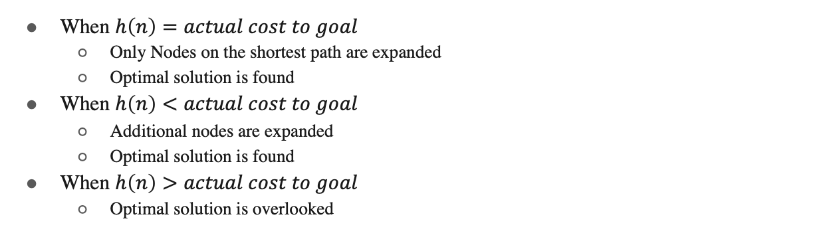
A* Search
When $h\left(n\right)=actual cost to goal$
Only Nodes on the shortest path are expanded
Optimal solution is found
When $h\left(n\right)<actual cost to goal$
Additional nodes are expanded
Optimal solution is found
When $h\left(n\right)>actual cost to goal$
Optimal solution is overlooked

Slide 52
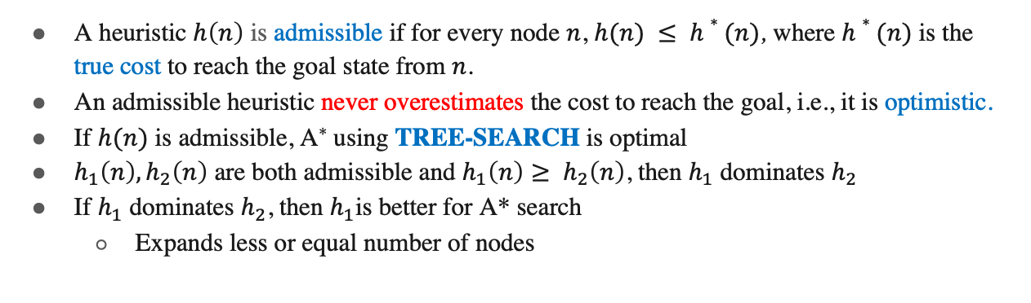
Admissible Heuristic and Dominance
A heuristic $h\left(n\right)$ is admissible if for every node $n$, $h(n) ≤ h∗(n)$, where $h∗(n)$ is the true cost to reach the goal state from $n$.
An admissible heuristic never overestimates the cost to reach the goal, i.e., it is optimistic.
If $h(n)$ is admissible, A* using TREE-SEARCH is optimal
$h_{1}\left(n\right), h_{2}\left(n\right)$ are both admissible and $h_{1}\left(n\right)≥ h_{2}\left(n\right)$, then $h_{1}$ dominates $h_{2}$
If $h_{1}$ dominates $h_{2}$, then $h_{1}$is better for A* search
Expands less or equal number of nodes

Slide 53



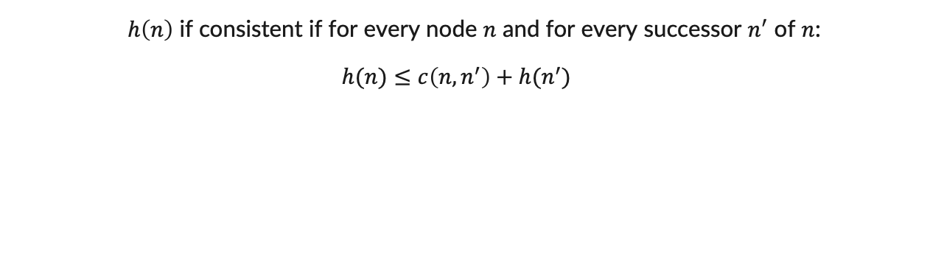



Consistent Heuristic
$h\left(n\right)$ if consistent if for every node $n$ and for every successor $n^{′}$ of $n$:
$$h(n)≤c\left(n,n^{′}\right)+h(n^{′})$$
$$h(n)$$
$$d$$
$$n$$
$$h(n^{′})$$
$$c\left(n,n^{′}\right)$$
$$n′$$

Slide 54
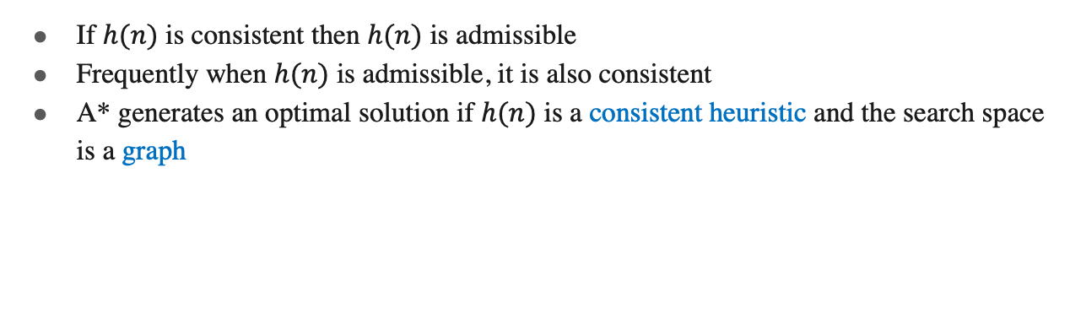
Consistent Heuristic
If $h(n)$ is consistent then $h(n)$ is admissible
Frequently when $h(n)$ is admissible, it is also consistent
A* generates an optimal solution if $h(n)$ is a consistent heuristic and the search space is a graph

Slide 55
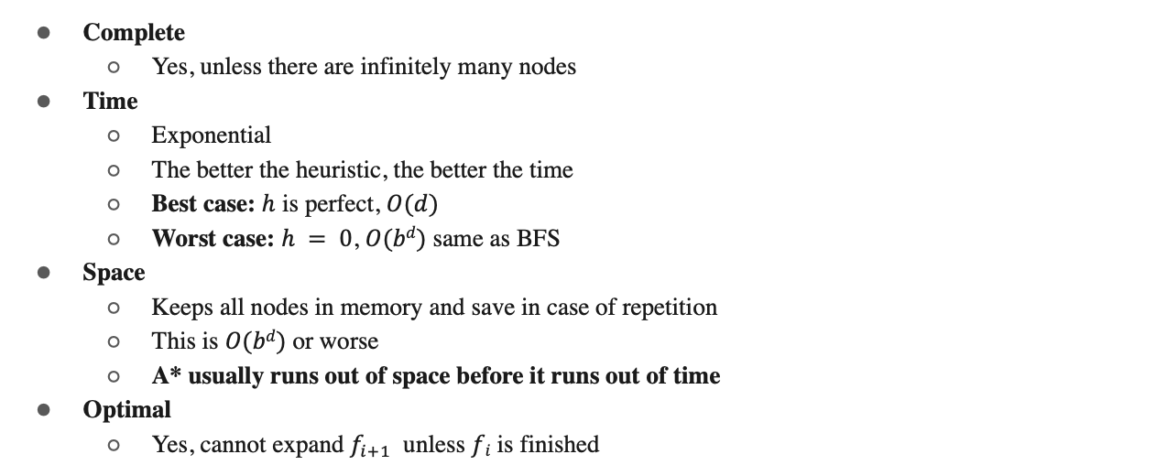
Performance
Complete
Yes, unless there are infinitely many nodes
Time
Exponential
The better the heuristic, the better the time
Best case: $h$ is perfect, $O(d)$
Worst case: $h = 0$, $O(bd)$ same as BFS
Space
Keeps all nodes in memory and save in case of repetition
This is $O(bd)$ or worse
A* usually runs out of space before it runs out of time
Optimal
Yes, cannot expand $f_{i+1}$ unless $fi$ is finished

Slide 56
Thank You !

